Slide 1
Introduction to Drafting

Slide 2
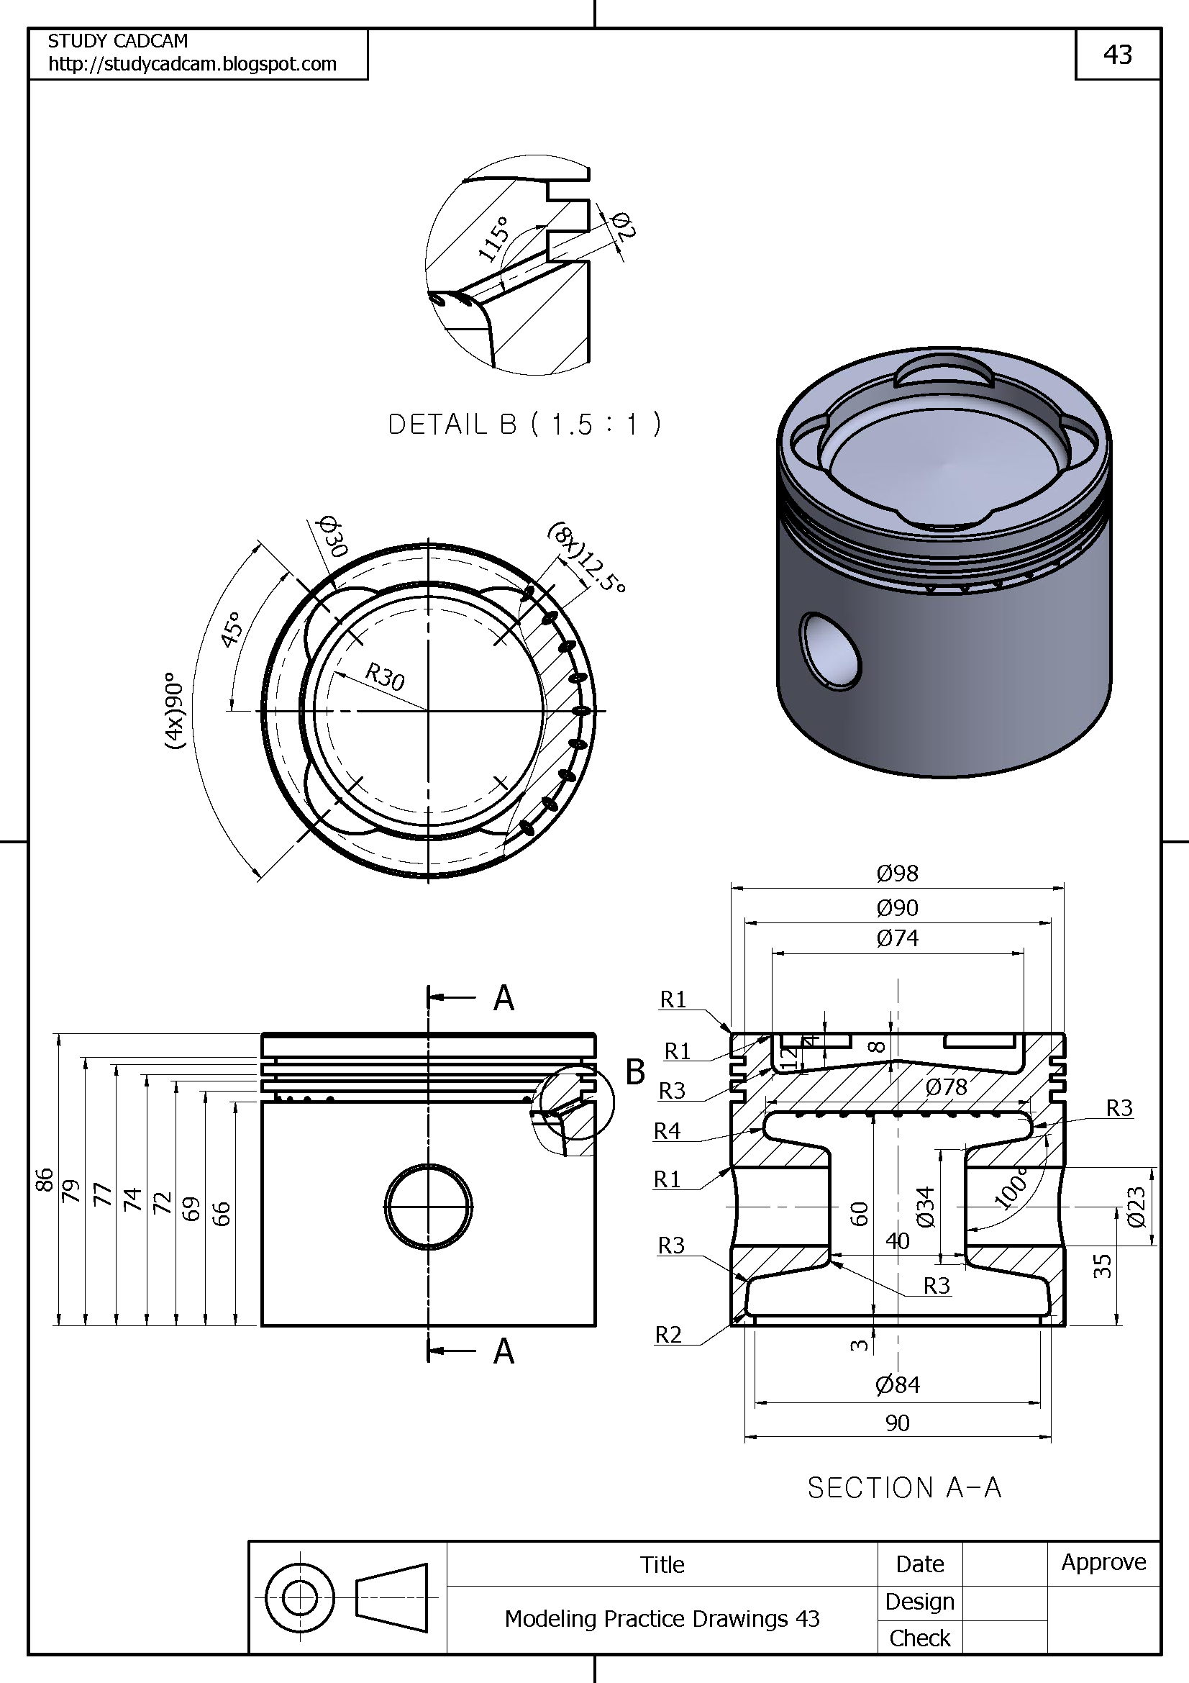
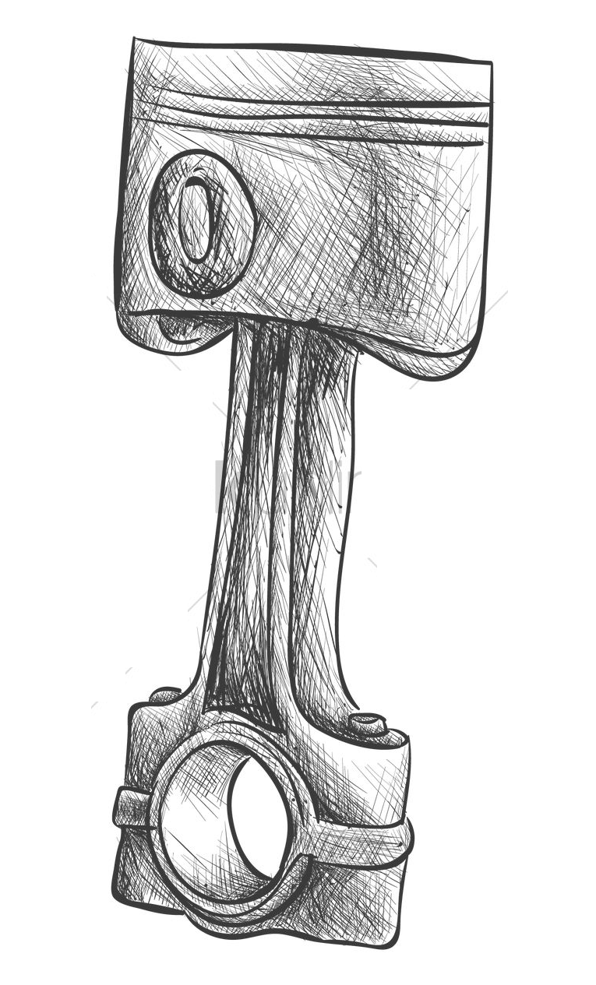
Artistic Versus Technical Drawing

Slide 3
What is Drafting?
Technical Drawings
A graphic language
Communication through drawings
To be able to MAKE something
In the end, will have dimensions.
Dimensions are universal. The same part can be made identical all over the world

Slide 4
Drafting: Communication Without words

Slide 5
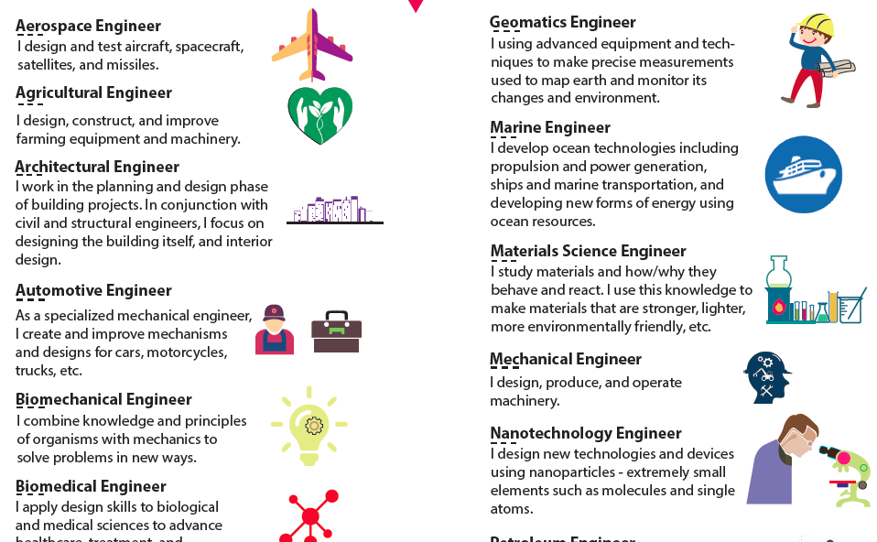
The many faucets of Drawing and Engineering
Mechanical
Electrical
Aerospace
Piping
Structural
Civil
Architectural
Landscaping
Technical Illustrator
And many more……..

Slide 6
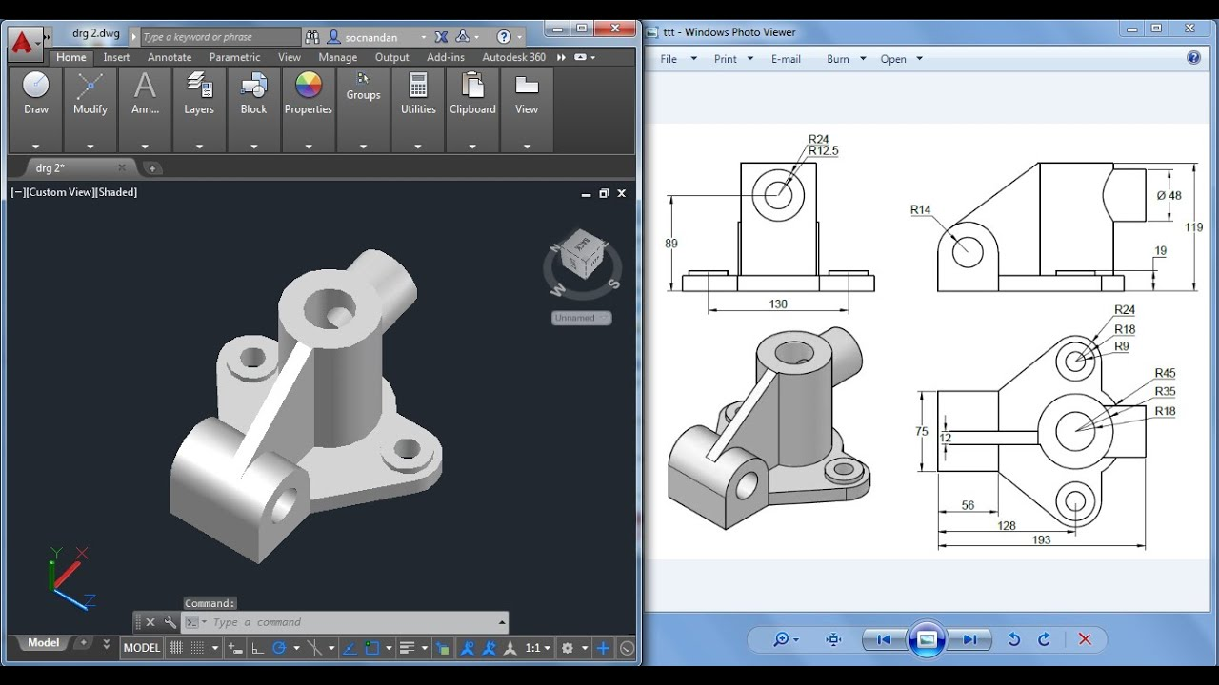
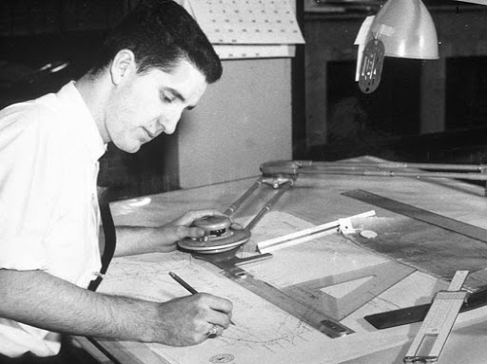
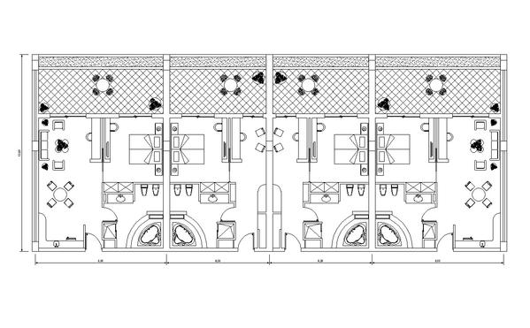
Hand Drawing versus CAD
Computer Aided Drawing and Design

Slide 7
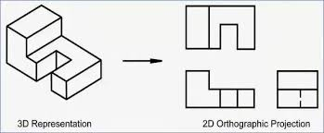
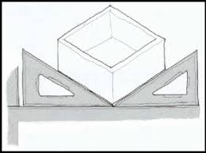
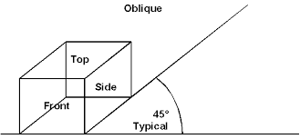
Types of Drawings
Isometric 30° 3d
Oblique 45° 3d
Orthographic 0° 2d

Slide 8
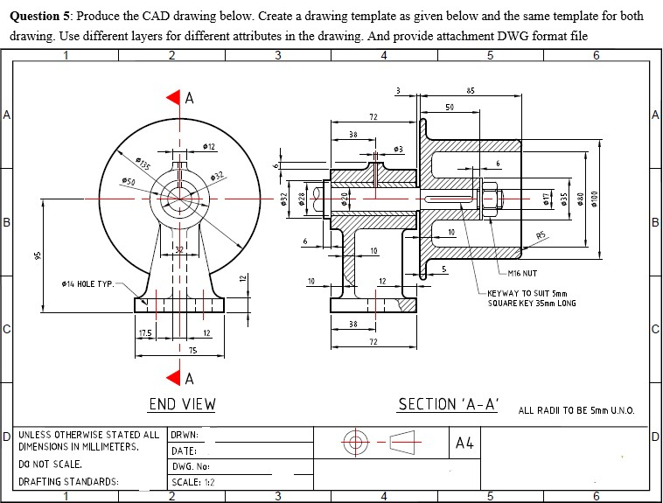
Drawing Standards – Who made the rules?
It is essential that different drafters use the same practices/language if drafting to be reliable mean of graphic communicating.
ISO – International Organization of Standardization (1946)
ANSI – American National Standards Institute – Committee of technical engineers, educators, businesses.

Slide 9
Units – Metric (mm) or Standard (in)

Slide 10
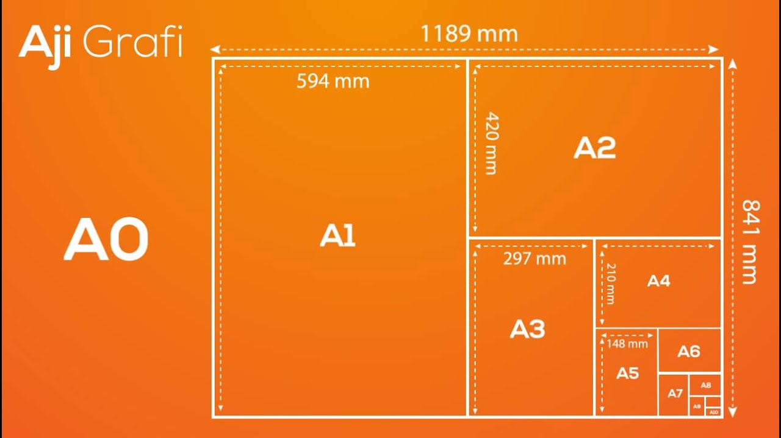
Paper Sizes – Metric versus Standard

Slide 11
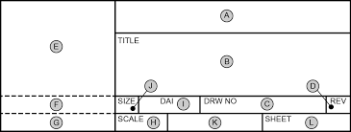
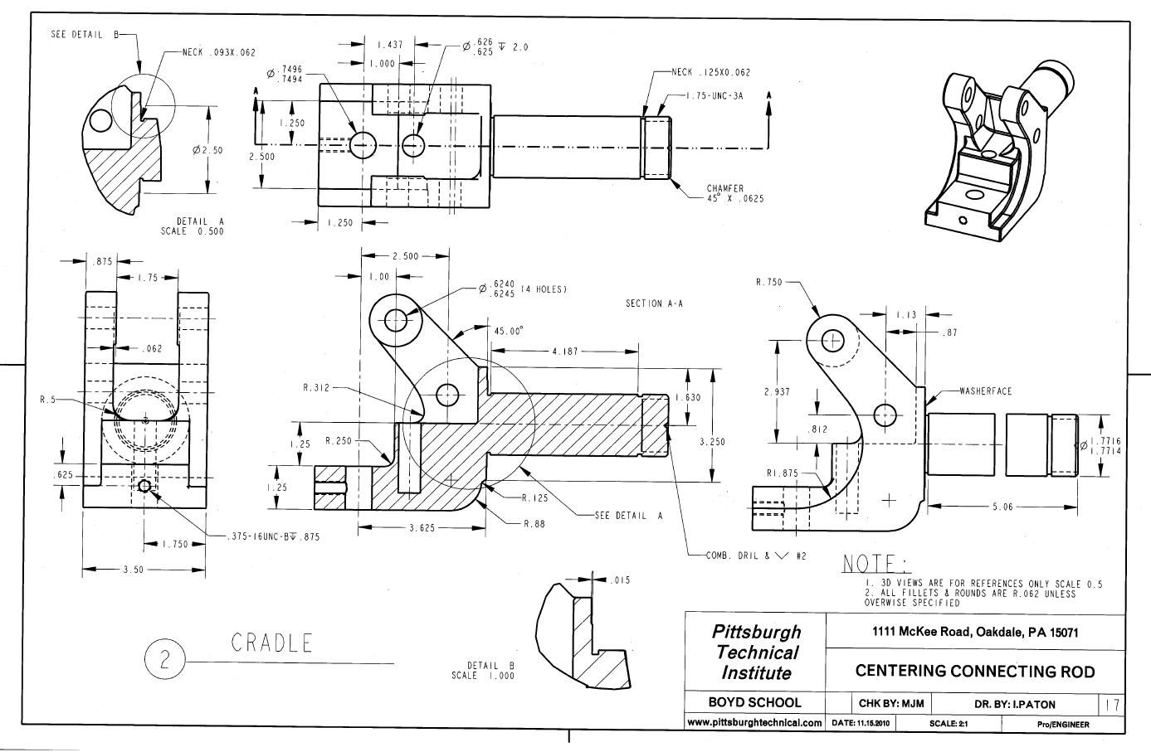
What is a Title Block?

Slide 12
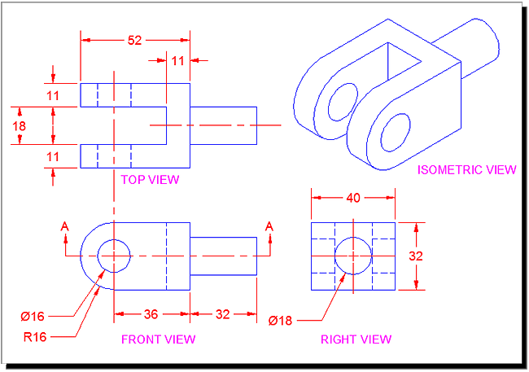
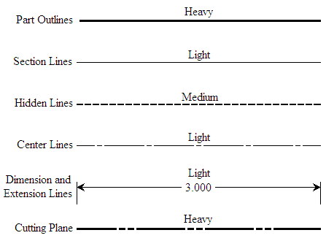
Linework - Types of Drawing Lines

Slide 13
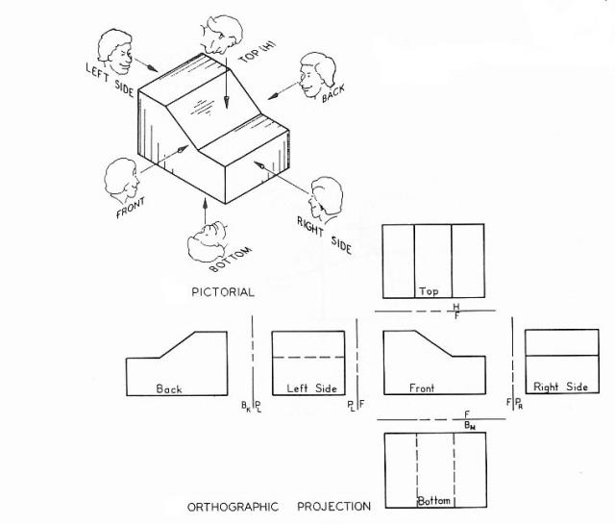
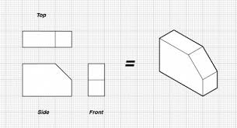
Orthographic Drawing:
Orthographic projection is a means of representing 3D objects in 2D

Slide 14
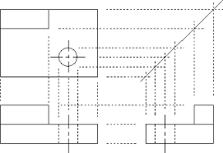
Orthographic Drawing: https://www.youtube.com/watch?v=ytwEDvX-l44
Usually 3 views to show the best representation
FRONT
TOP
SIDE (usually Right Side)

