Slide 1
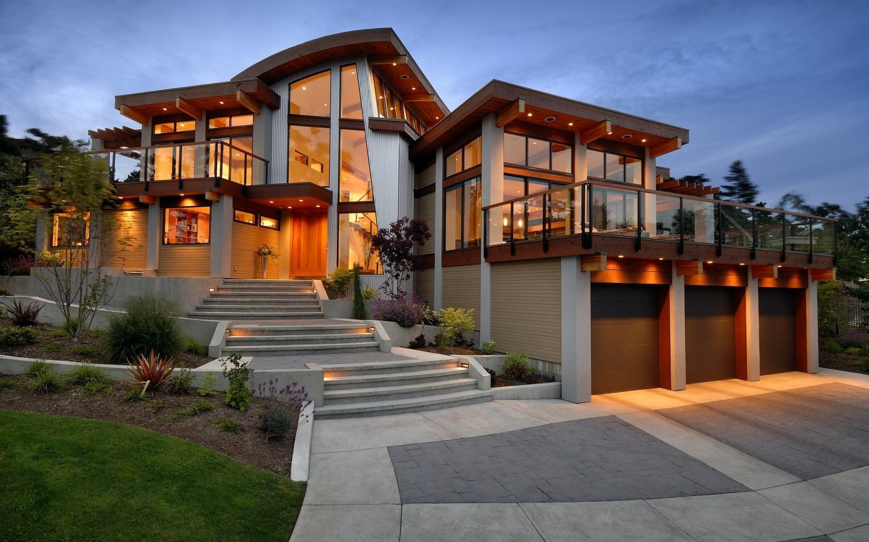
Architecture Unit: House Design Inspiration Template
KSS Senior Drafting 11-12

Slide 2
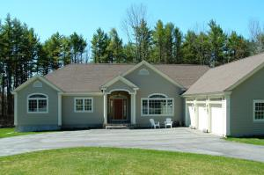
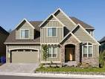
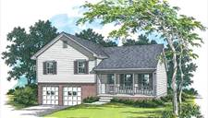
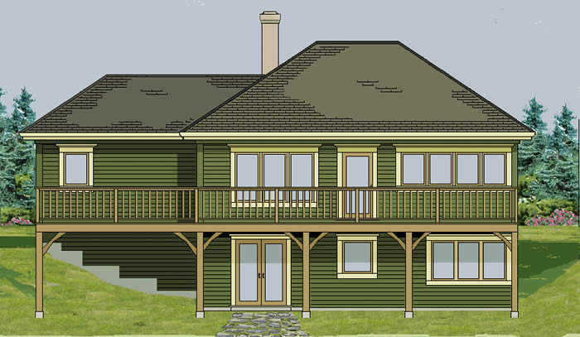
What style of house?
Rancher/Bungalow
Split Level
2 Story
Basement
Walk-out

Slide 3
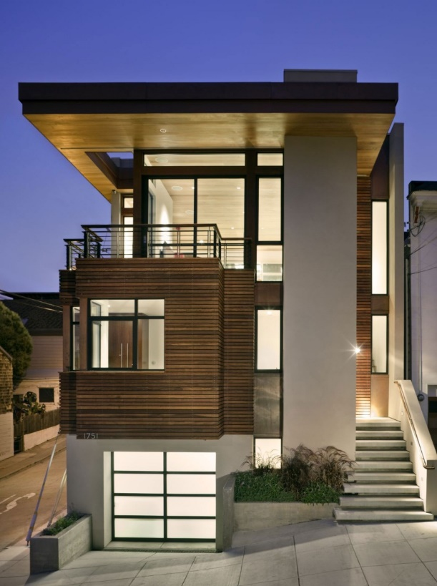
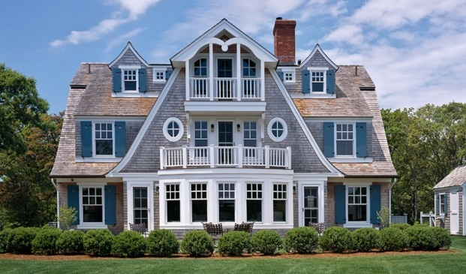
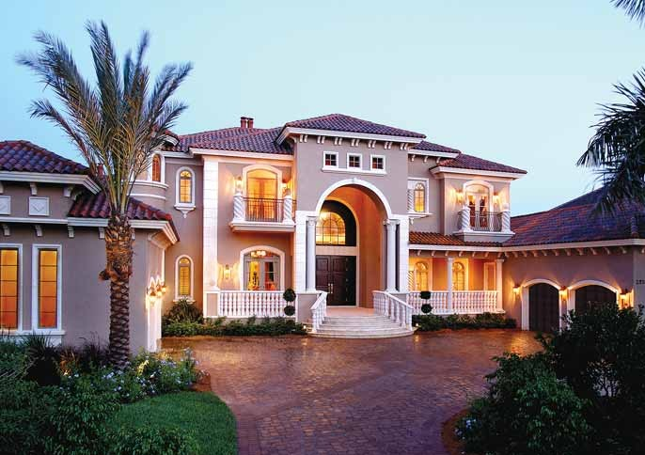
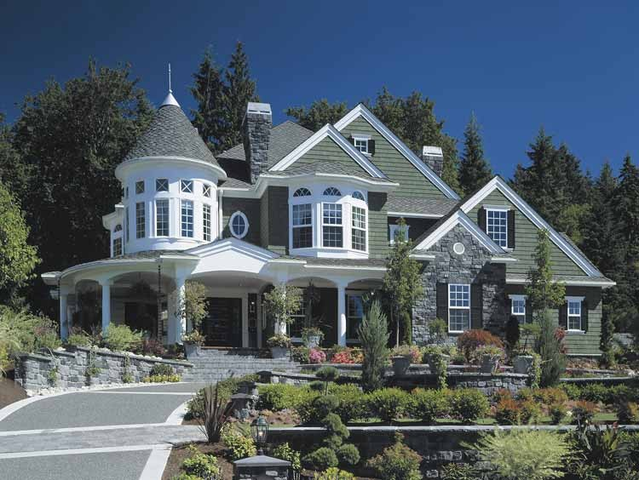
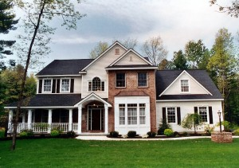
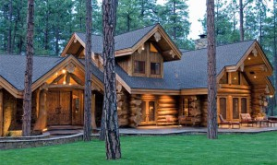
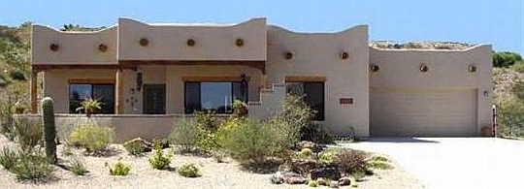
What Architecture Style?
Cape Cod
Modern/Contemporary
Mediterranean
Traditional
Sante Fe
Victorian
Rustic/Log Home
And much more!!

Slide 4
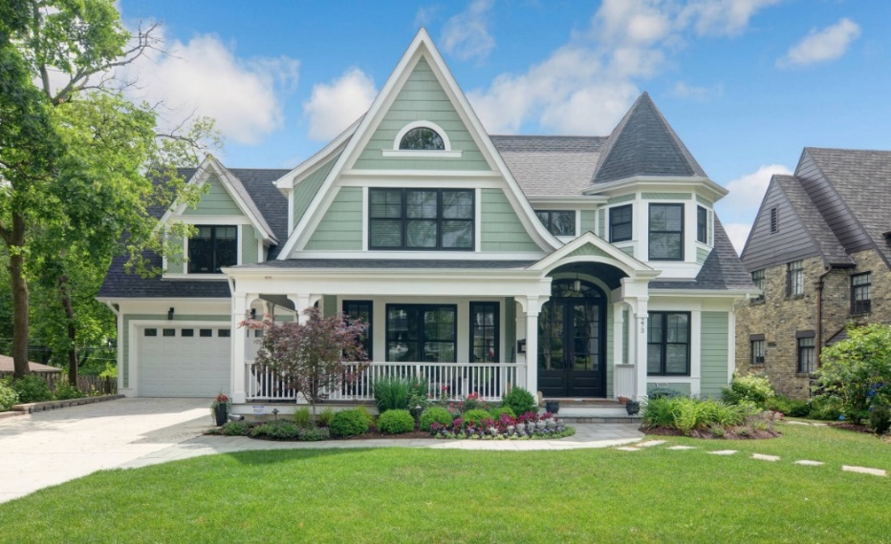
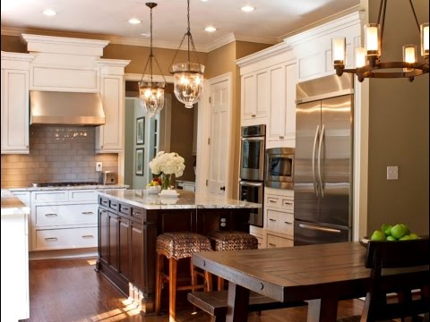
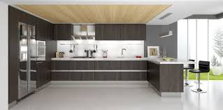
Interior Design
Should match the exterior style
Ex: A Victorian house should not have a ultra modern kitchen
Use the Houzz Ap and internet for idea inspirations

Slide 5
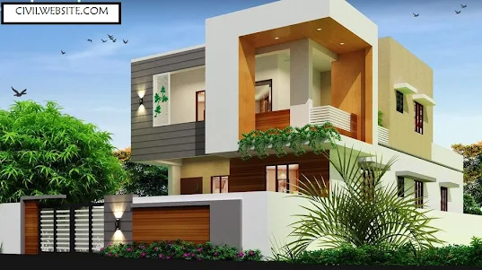
Your Inspiration: Exterior (frontage)
Should have several Depths and various materials

Slide 6
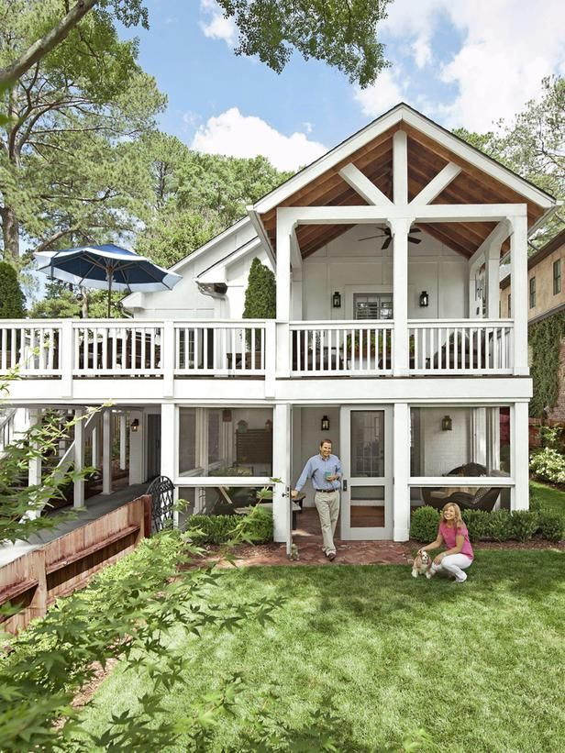
Your Inspiration: Exterior (Back of house)
Decks or outdoor living
Is the roof line incorporated?

Slide 7
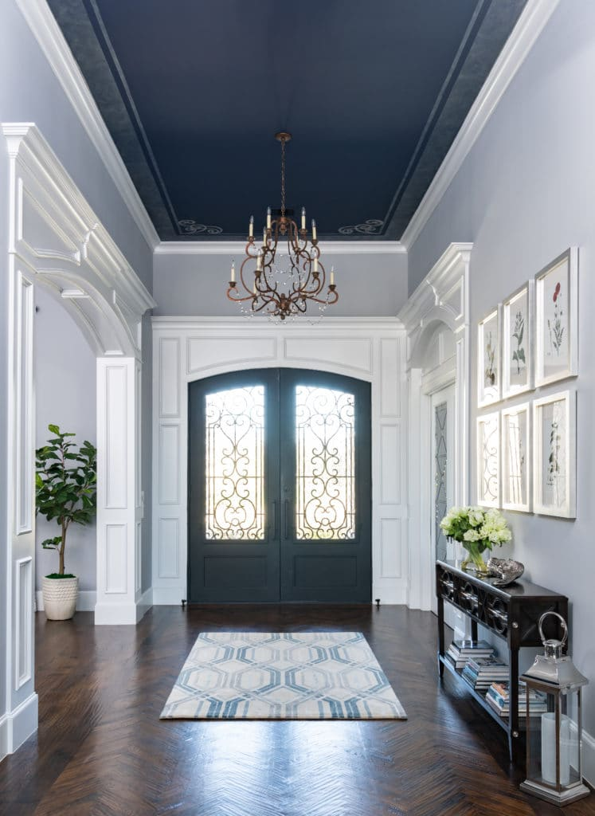
Your Inspiration: Entry Way
Most entry ways have storage nearby (closets)

Slide 8
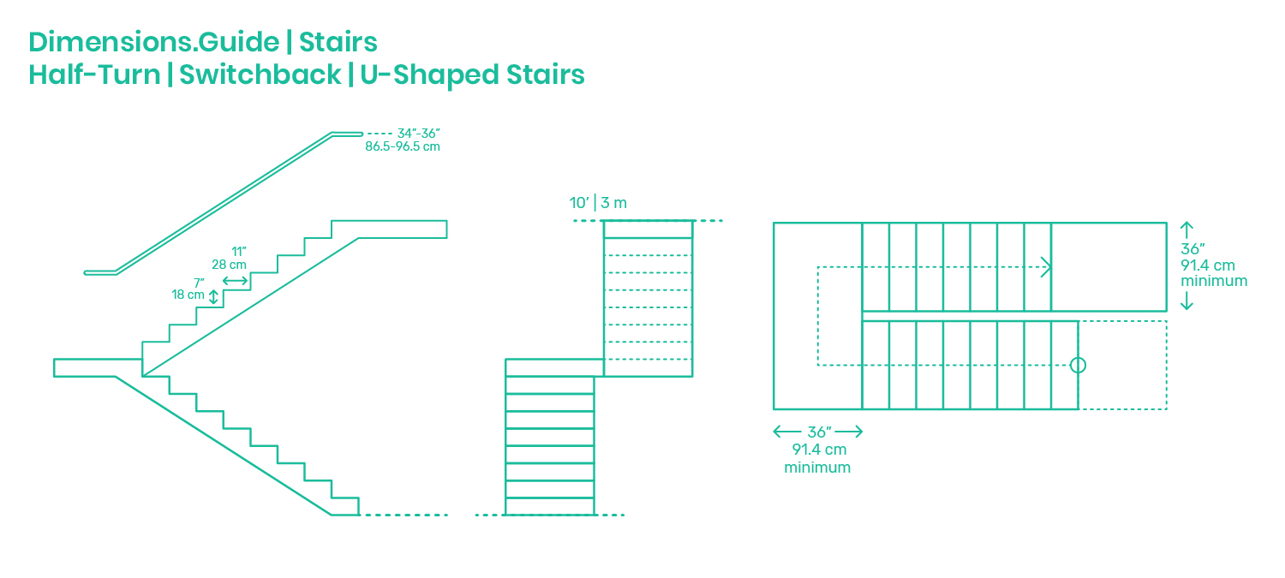
Your Inspiration: Stairs

Slide 9
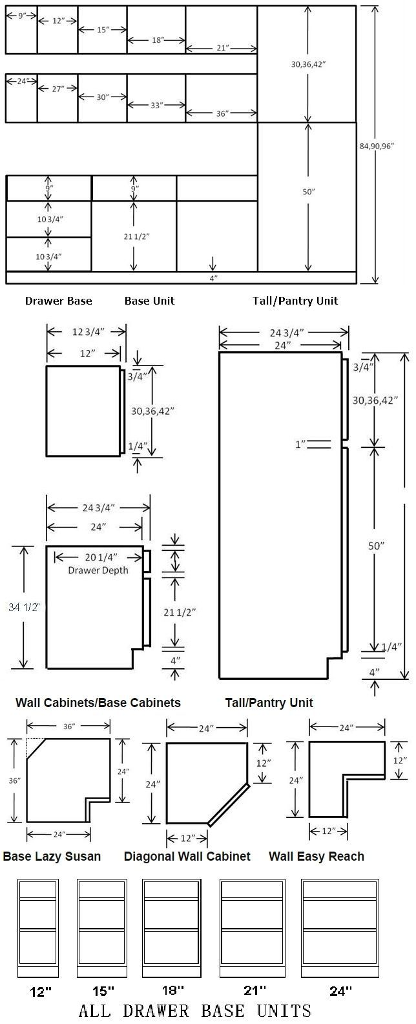
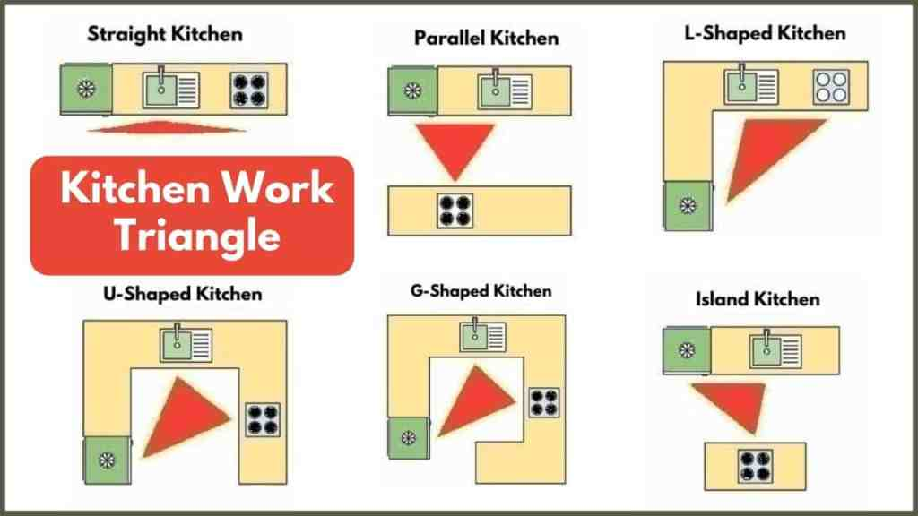
Your Inspiration: Kitchen
Functional work Triangle
Islands need 42” minimum space surrounding
Consider how cabinets are sized

Slide 10
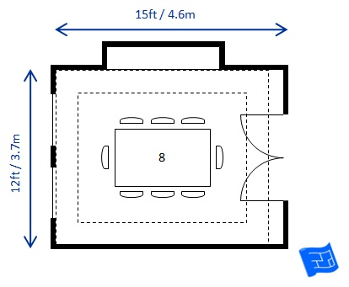
Your Inspiration: Dining Room
What size of table?? Walking space around table.
Do you plan on incorporating some sort of hutch in this space

Slide 11
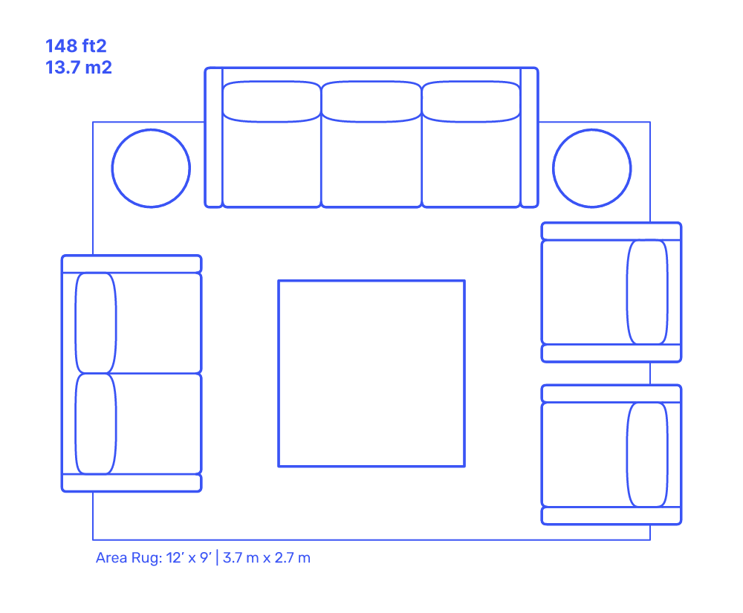
Your Inspiration: Living/Family Rooms

Slide 12
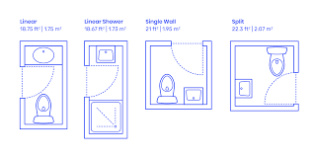
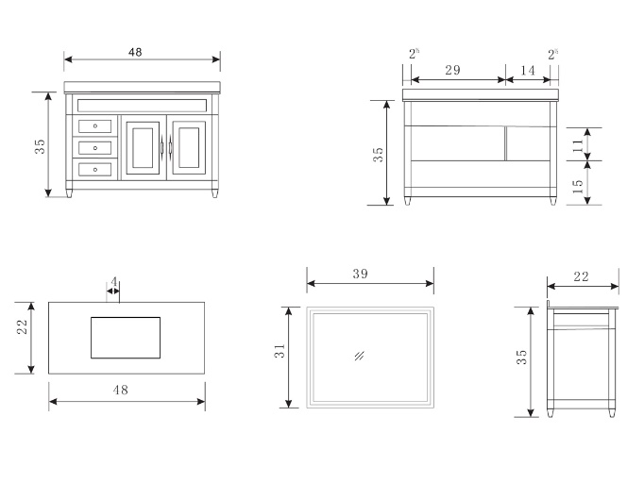
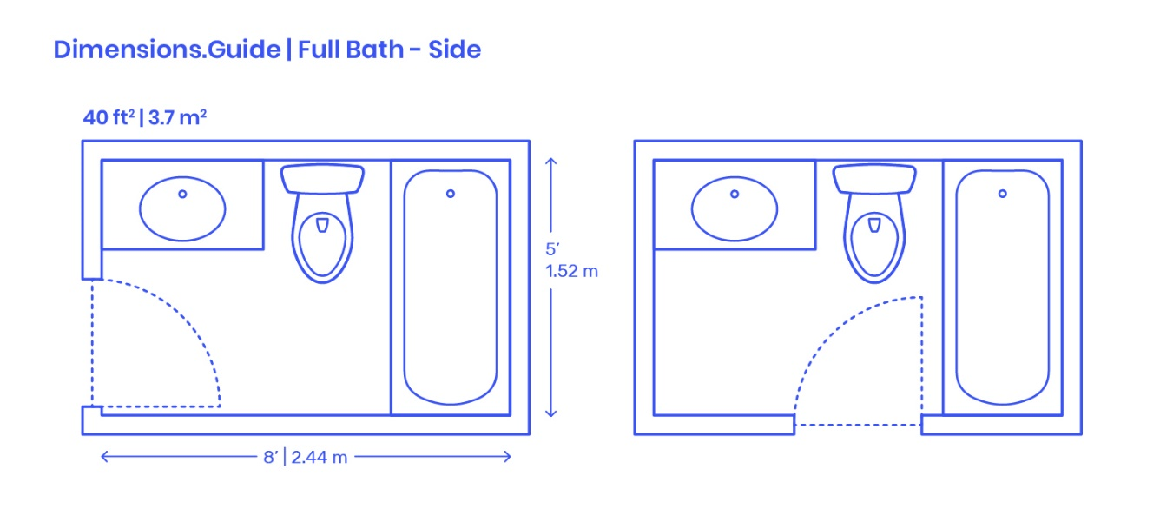
Your Inspiration: Bathrooms

Slide 13
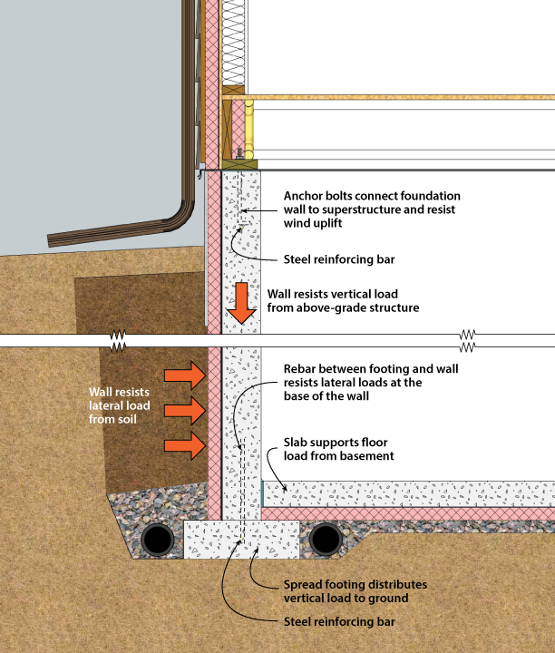
Your Inspiration: Basements/Footings/Foundations

Slide 14
Your Inspiration: Games rooms/fun rooms

Slide 15
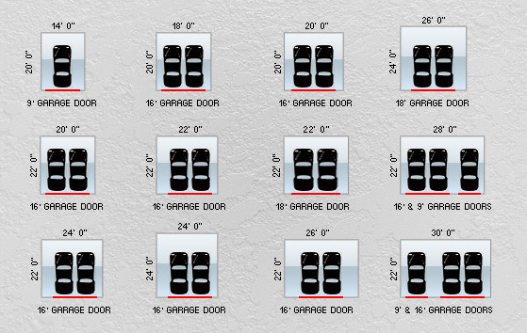
Your Inspiration: Garage space

Slide 16
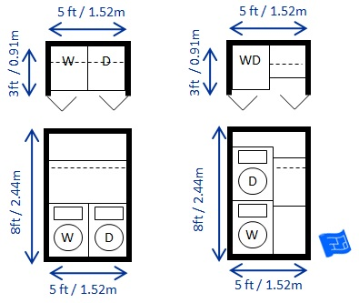
Your Inspiration: Utilities/Laundry space

Slide 17
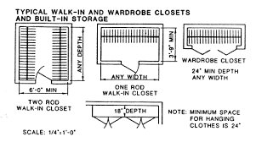
Your Inspiration: Storage CLOSETS

Slide 18
Your Inspiration: Anything else?

Slide 19
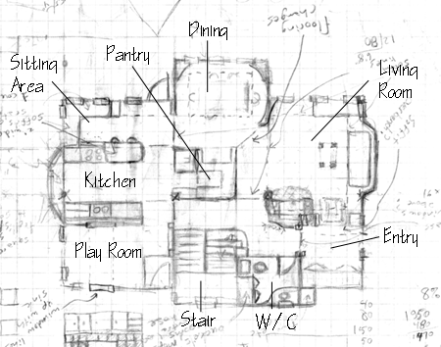
DAY 2 - Your Inspiration: The Design Sketch
House limitations: Max 5000sqft (which is HUGE by the way)
Please make a sketch using graph paper provided of your proposed house plan.
Incorporate the design elements you researched into your plan.
Estimate the size of each room in feet and inches

